Slide 1
Enabling the Grid, Utility, and "Prosumer" of the Future
Scott Burger
Co-authors: Ignacio Perez-Arriaga, Chris Knittel, Frederik vom Scheidt, Ian Schneider
November 29, 2018

Slide 2
What we will talk about today:
The evolving power sector: the keystones of a regulatory framework
The role of price signals in enabling the grid, utility, and “prosumer" of the future
Breaking with the past: new methods for equitable and efficient rate design
Notes:
(Pose the key question of the talk. Why is everyone so excited/concerned about an impending/disruptive “distributed revolution”?)

Slide 3
The evolving power sector: the keystones of a regulatory framework
Notes:
(Pose the key question of the talk. Why is everyone so excited/concerned about an impending/disruptive “distributed revolution”?)

Slide 4
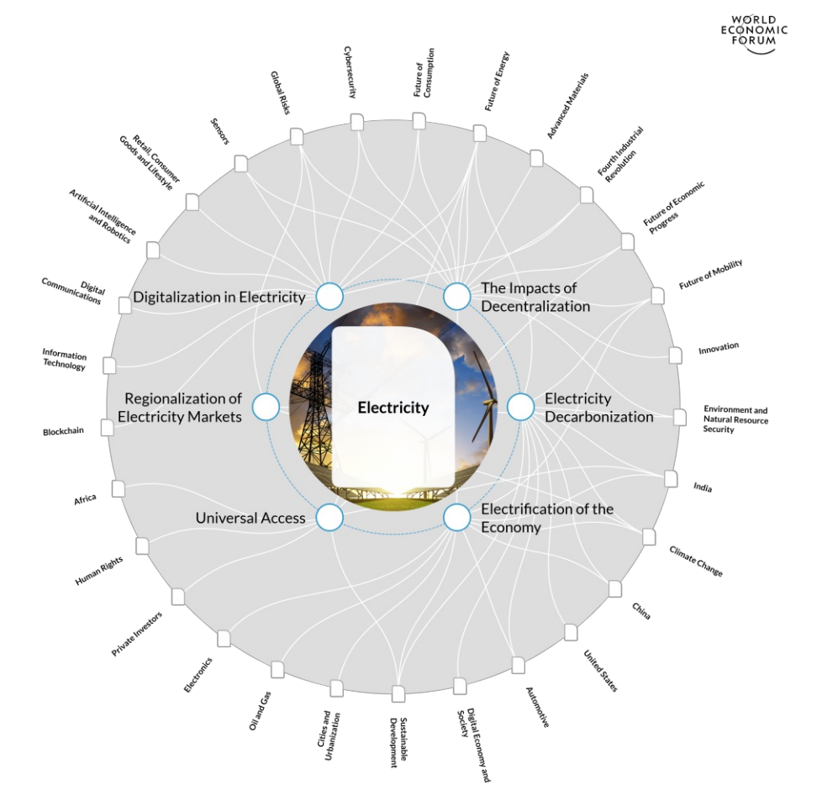
The Utility of the Future’s focus was on the “three D’s” – digitalization, decentralization, and decarbonization However, regionalization, electrification, and the quest for universal electricity access are all shaping the future of the sector
Source: Ignacio Perez-Arriaga and Scott Burger, 2017. Electricity Industry Transformation Map. World Economic Forum.

Slide 5
The Utility of the Future outlined a regulatory framework in the spirit of The Little Prince author Antoine de Saint-Exupéry
“L'avenir, tu n'as point à le prévoir mais à le permettre”
“The future, you do not have to foresee it, but to enable it”

Slide 6
Get the financial incentives right for DER providers and utilities.
The 360 page study can be summarized in three sentences:
1
2
3
Remove the barriers for DERs to provide value.
DERs hold promise to improve system outcomes, but smaller is not always better.

Slide 7
Get the financial incentives right for DER providers and utilities.
Improving incentives requires improving rate design, reforming network company remuneration, and ensuring industry structure meets today’s requirements
Price signals must dramatically improve to ensure DERs create value.
Network remuneration must incentivize utilities to pursue beneficial non-wires alternatives.
1
Industry structure must align with goals for competitive provision of energy services.

Slide 8
The role of price signals in enabling the grid, utility, and “prosumer" of the future
Notes:
(Pose the key question of the talk. Why is everyone so excited/concerned about an impending/disruptive “distributed revolution”?)

Slide 9
After thousands of hours of research, MIT determined that DERs are not unicorns – DERs provide electricity services like energy, capacity, and constraint mitigation at the locations in which they are most valuable

Slide 10
When installed in the right locations and operated intelligently, DERs can bring significant benefits to the power sector
Source: M.A. Cohen, P.A. Kauzmann, D.S. Callaway, Effects of distributed PV generation on California’s distribution system, part 2: Economic analysis, Solar Energy, Volume 128, 2016, 139–152

Slide 11
DERs are often substantially more expensive than their more centralized counterparts – economies of scale still matter, and must be considered when analyzing value
Distributed solar is 4.4x – 6.1x the cost of centralized solar
Source: Lazard, 2018. Levelized Cost of Energy Analysis – Version 12.0.

Slide 12
DERs are part of a broader system, and, if deployed and operated without care, DERs can drive system costs and emissions
A review of California’s energy storage incentive program found that energy storage systems were:
Increasing system emissions
Increasing peak demand for some customers
A recent review of the impact of California’s distributed solar estimated that:
“2/3 of the increase in residential distribution network costs for each of the three utilities between 2003 and 2016 can be attributed to the growth of distributed solar capacity.”
Source 1: Itron, 2017. 2016 SGIP ADVANCED ENERGY STORAGE IMPACT EVALUATION.
Source 2: Wolak, 2018. Evidence from California on the Economic Impact of Inefficient Distribution Network Pricing and a Framework for a Proposed Solution

Slide 13
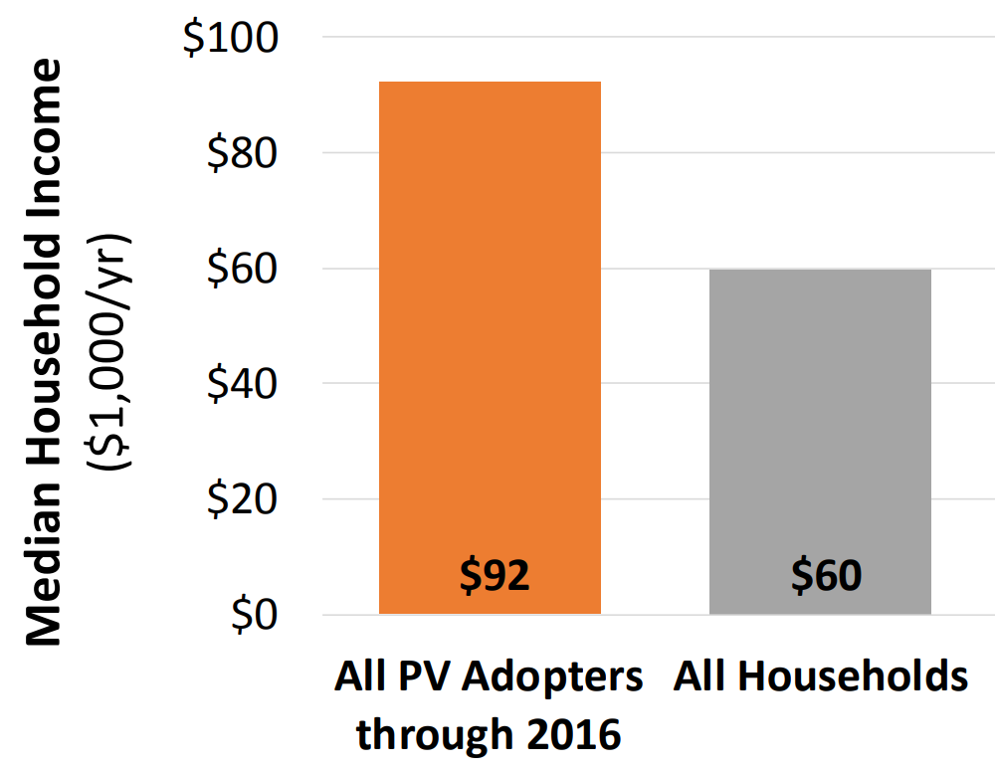
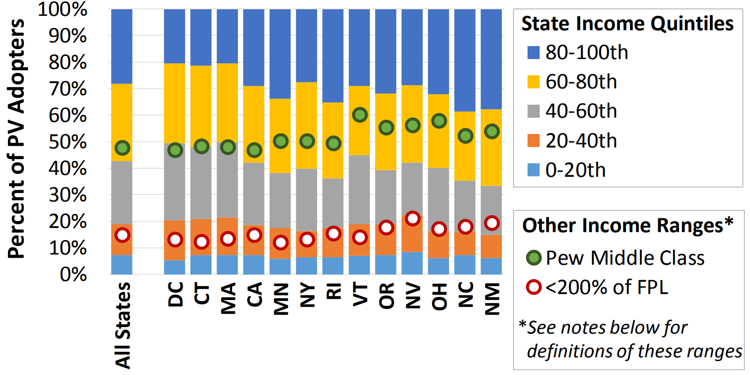
To the extent that DER adoption creates residual cost shifts, the shift is likely to be from high income customers to low income customers
Median solar owners are >50% wealthier than non-owners, and more than 80% of solar adopters are in the top 3 income quintiles
Source: Barbose et al., 2018. Income Trends of Residential PV Adopters An analysis of household-level income estimates.

Slide 14
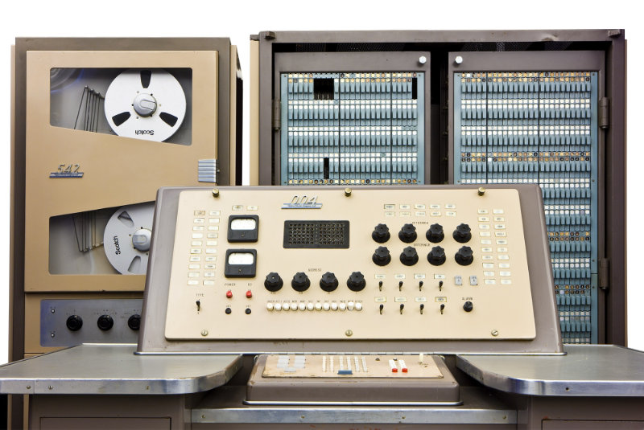
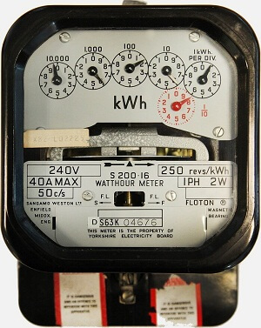
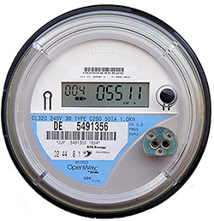
Yesterday’s assumptions about rates are outdated, and rates must play an additional role – rates must now help ensure beneficial DER adoption
Yesterday’s assumptions:
We can’t compute and communicate price signals ……
We can’t meter customers…………..…………… .
Customers can’t respond to price signals……………
Customer response has limited impact………………
Yesterday
Today’s reality

Slide 15
Of course, economic efficiency is not the only criteria – California’s ratemaking principles highlight the importance of equity considerations
“1. Low Income and medical baseline customers should have access to enough electricity to ensure basic needs (such as health and comfort) are met at an affordable cost;
2. Rates should be based on marginal cost;
…”
Source: CPUC, n.d. Residential Rate Reform / R.12-06-013. Available online: http://www.cpuc.ca.gov/General.aspx?id=12154

Slide 16
Breaking with the past: new methods for equitable and efficient rate design
Notes:
(Pose the key question of the talk. Why is everyone so excited/concerned about an impending/disruptive “distributed revolution”?)

Slide 17
Tomorrow’s rate designs must:
Be technology neutral and symmetrical
Be aligned with marginal system costs
Recover residual network and policy costs without causing major distortions
Address distributional concerns with efficient mechanisms

Slide 18
To test these ideas, we built a model of ComEd’s costs, and analyzed nearly all considered rate designs with smart meter data from >100,000 ComEd customers
Flat
Time-of-use
Various allocation methods
Critical peak price
Real time price
Demand charge
Fixed charge
$

Slide 19
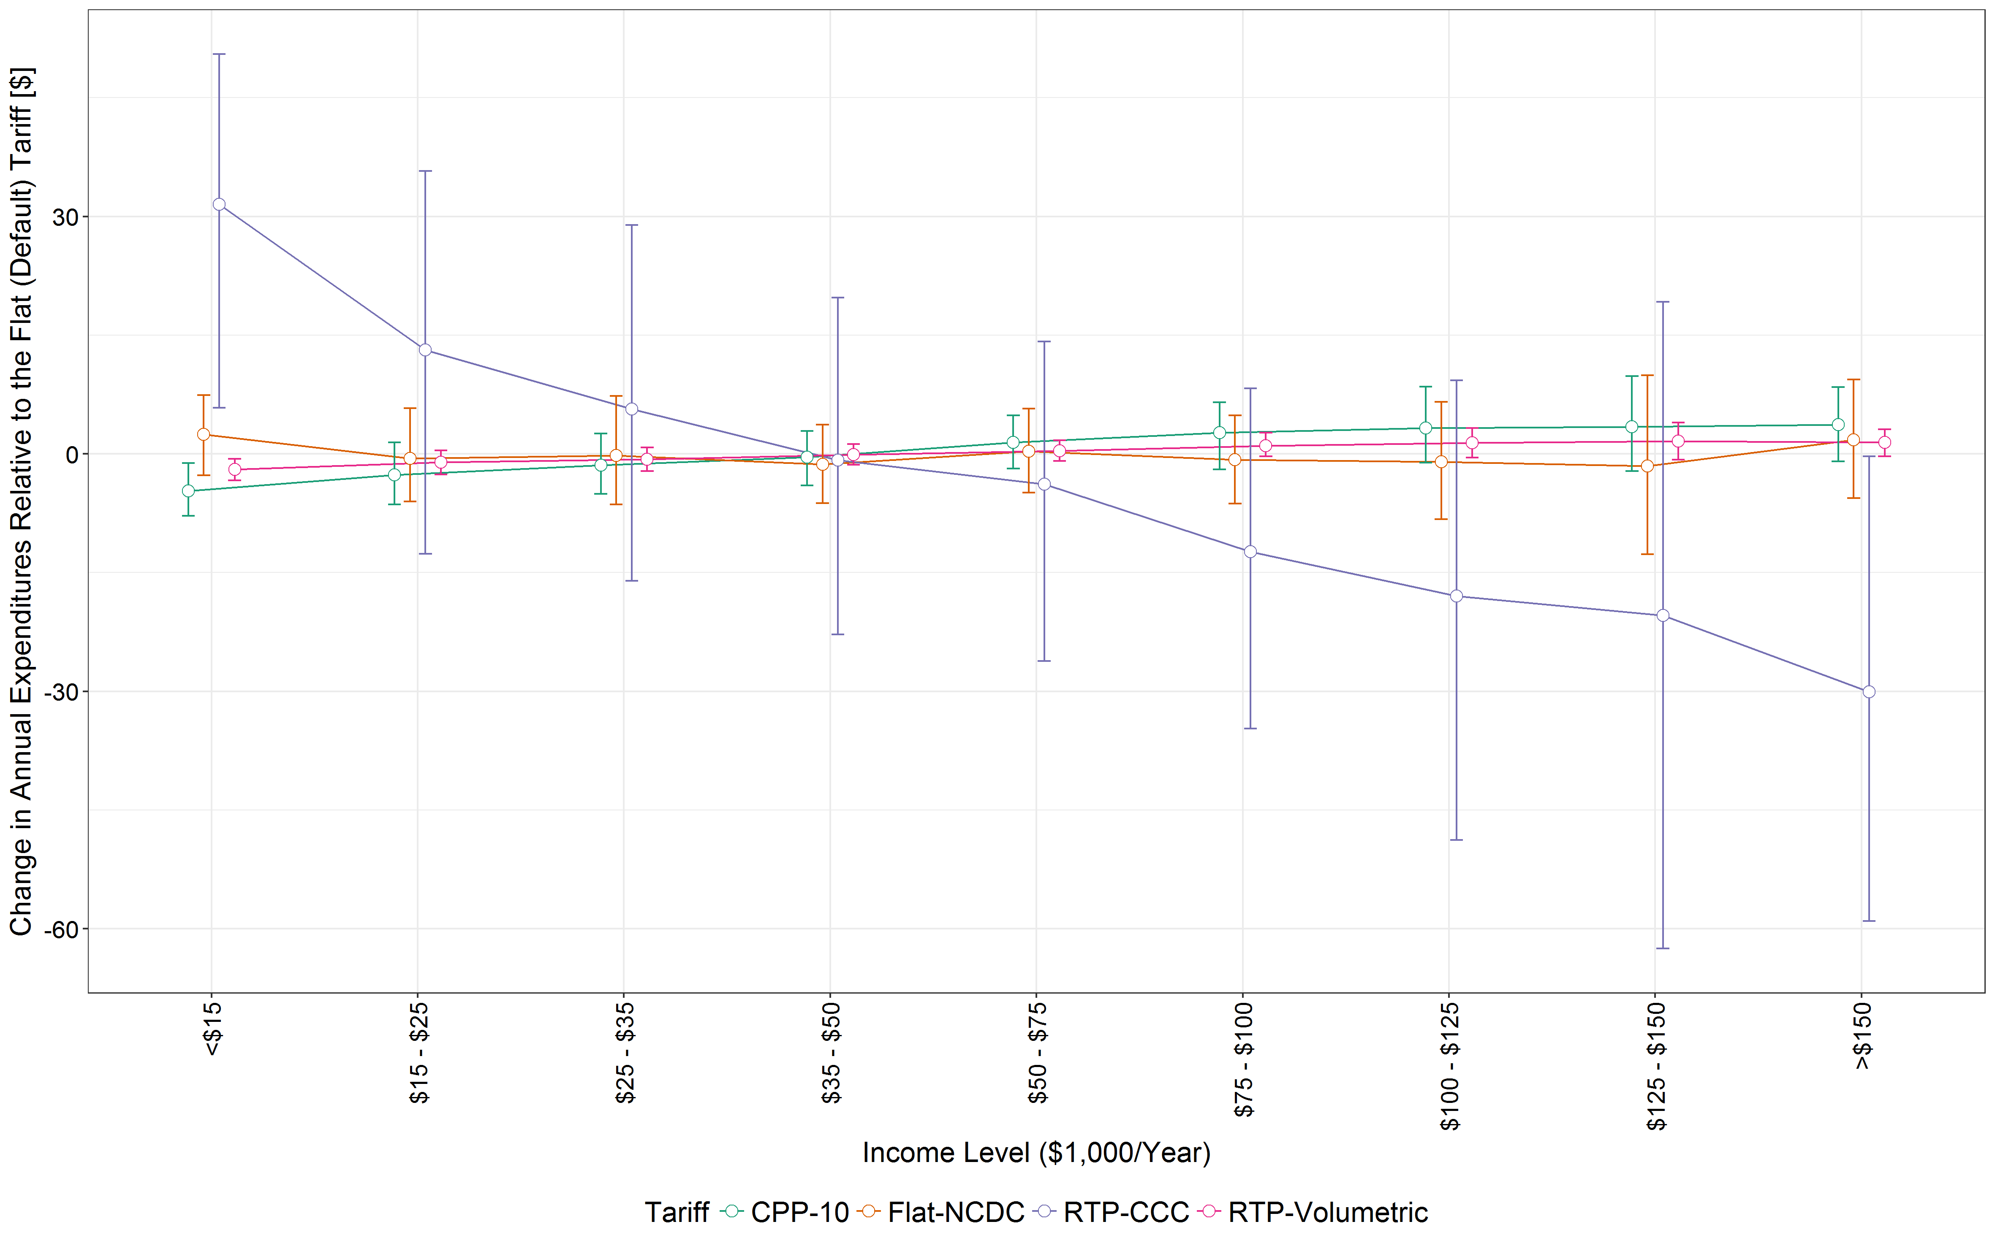
Increasing fixed charges increase expenditures for low-income customers, but moving to real-time prices does not
Changes in customer bills relative to the flat (default) tariff

Slide 20
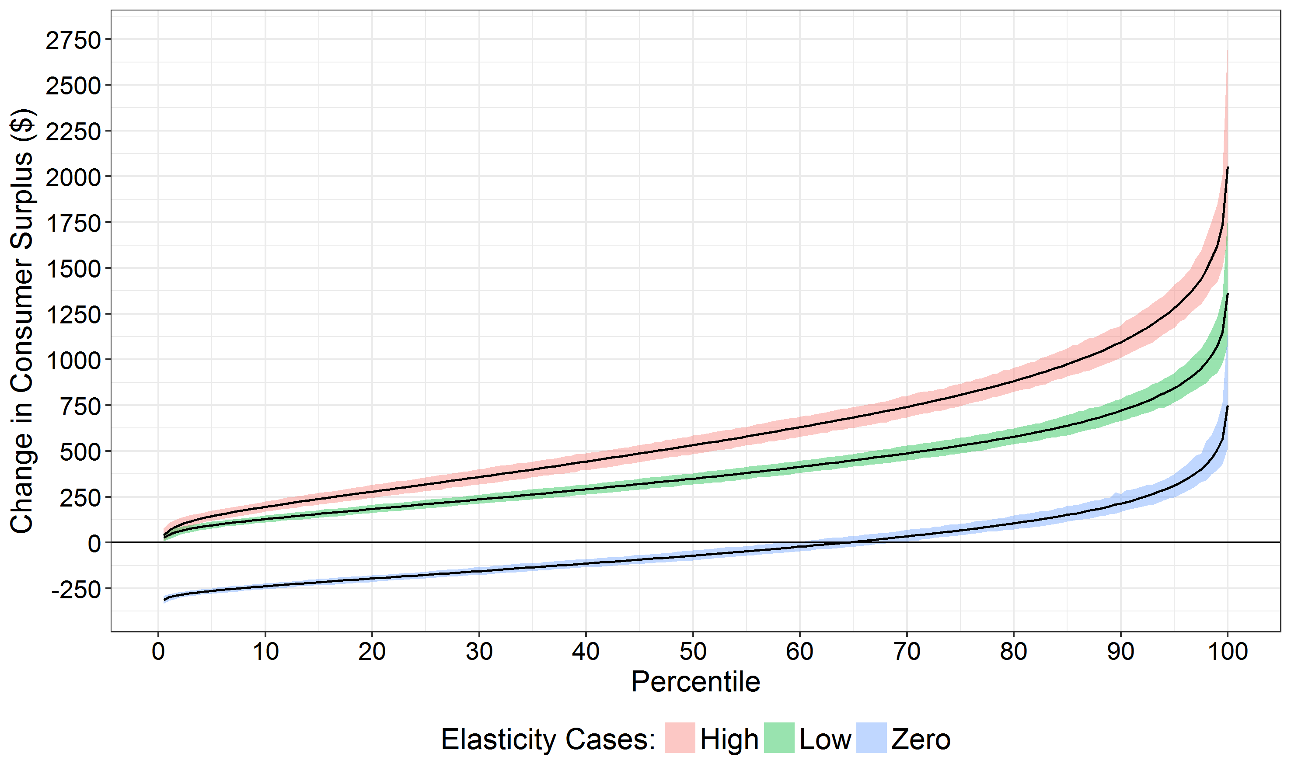
An efficient rate design increases consumer surplus for all customer segments at very low levels of price elasticity
Changes in consumer surplus for customers making <$15,000 per year relative
to the flat (default) tariff

Slide 21
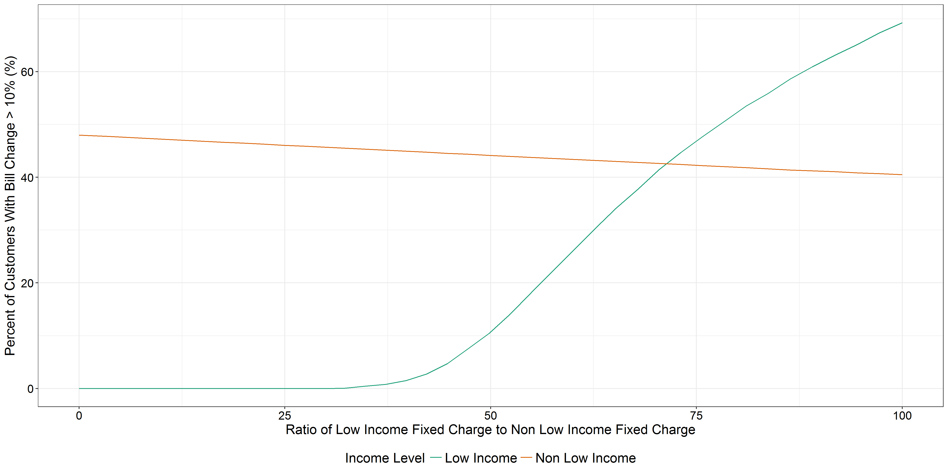
With smart meter data and available customer demographic data, it is possible to target rebates or incentives to those who need them most
Progressive fixed charges can ensure that no low-income customers see bill increases

Slide 22
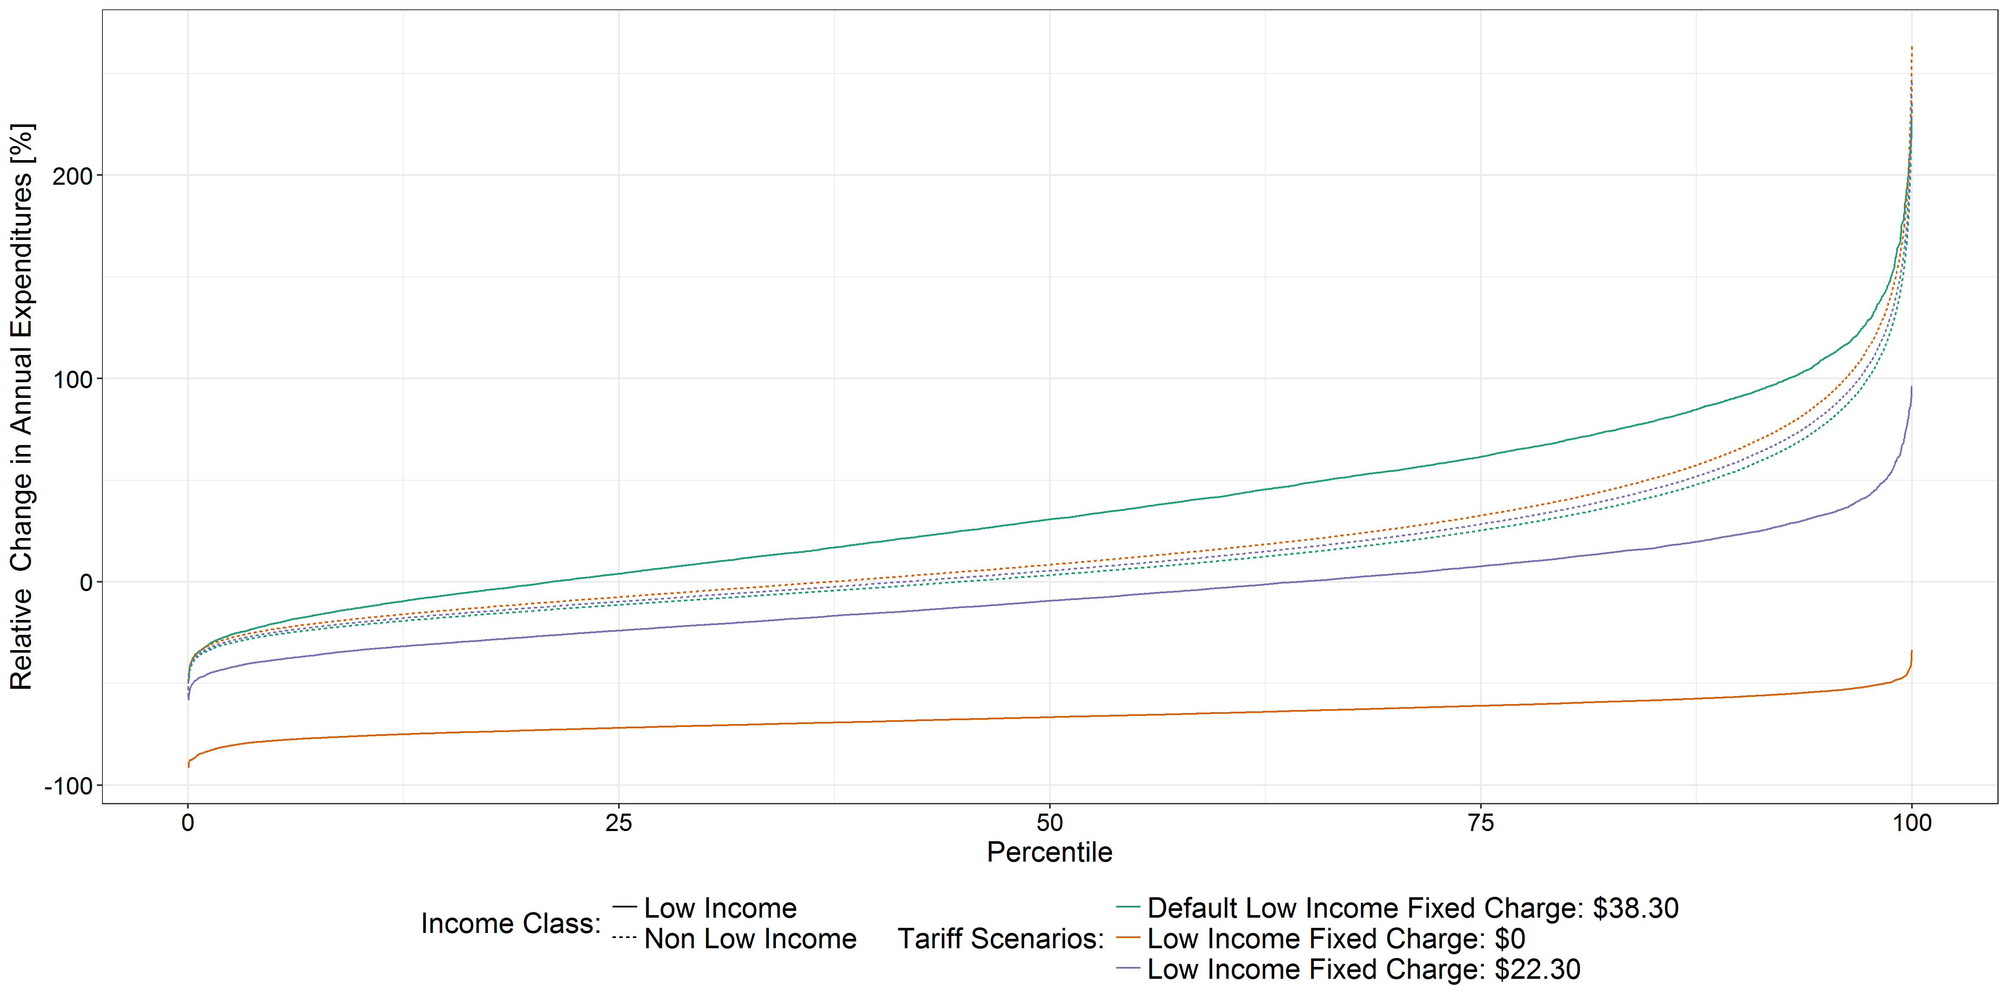
By tuning rebates for low-income customers, we can design efficient tariffs in which all low-income customers benefit relative to today’s tariffs
Bill changes in the transition from a flat to a real-time pricing tariff with progressive fixed charges

Slide 23
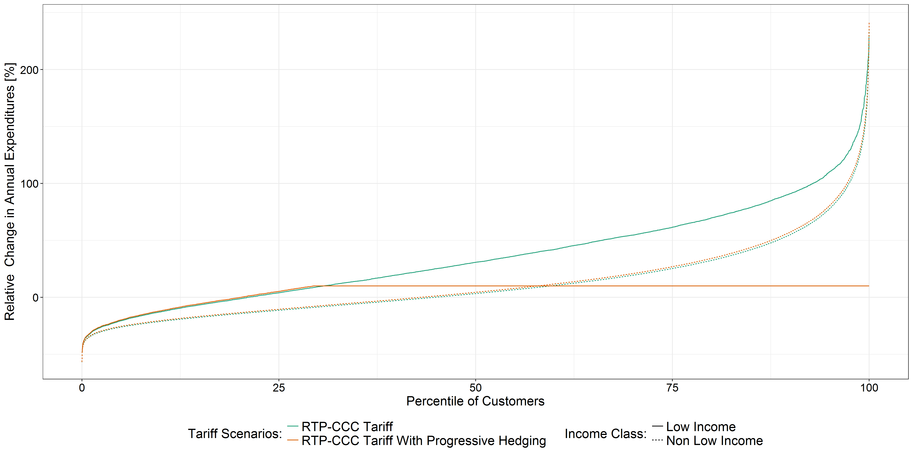
Protections provided to low-income customers can be designed to have minimal bill impacts on other customers
Progressive hedges protect low-income customers at minimal cost to non-low-income customers

Slide 24
Thank you sburger@mit.edu

Slide 25
We combine a variety of datasets to better understand the impacts of today’s tariffs and efficient tariffs on different customer groups
100,170 anonymized residential customers
30-minute smart meter reads
Geographic data (9-digit zip)
Customer Service Class
Data source: ComEd and Citizens Utility Board
Manifold socio-economic data on Census Block Group level
Median Income
Population by race
Population by age groups
Population by employment status
Housing stock
Data source: US census 2010-2015

Slide 26
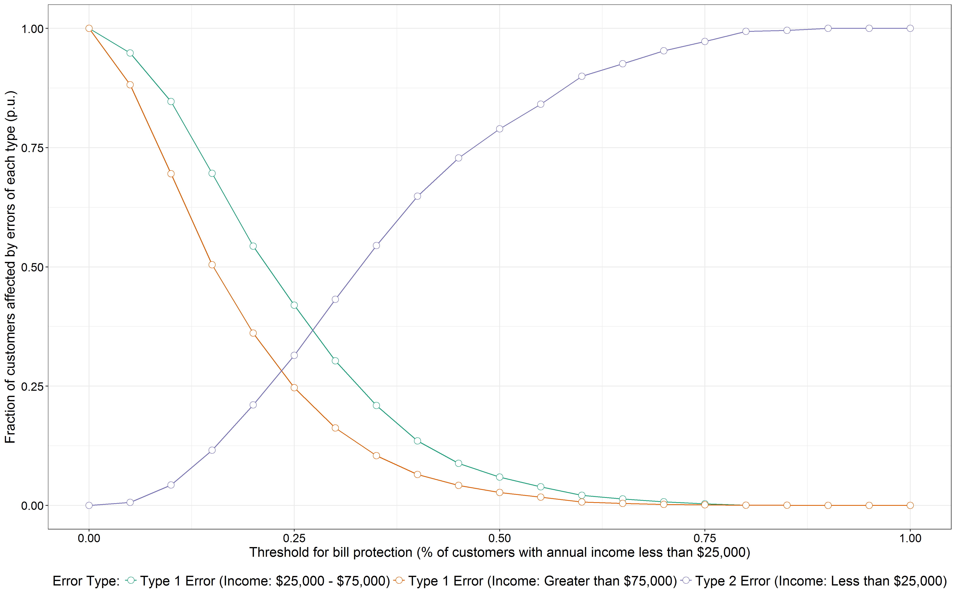
With only small amounts of data, we can improve customer protections relative to programs like LIHEAP
Using census data, we can target supports to low income areas

